Slide 1
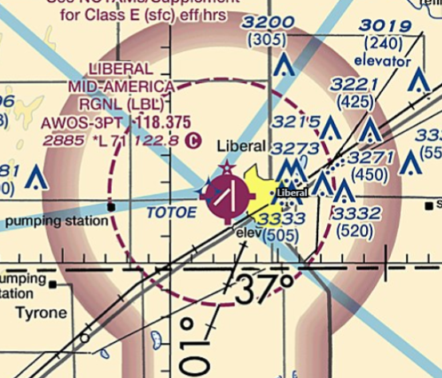
Airspace
Q
You are flying into KLBL. To what altitude does the Class E airspace around KLBL extend down to?

Slide 2

Airspace
At first, the Class E extends down to 700 AGL (gradient magenta line). But as you get closer to the airfield, the dashed magenta line tells us the Class E around KLBL extends to the surface.
Dashed magenta line.
Gradient magenta line.

Slide 3
Airspace
Q
Can a student pilot fly in Class B airspace?
What must they receive first??
61.95(a)
ACS - PA.I.E.K1

Slide 4
Airspace
Yes.
Training for the specific Class B airspace and a logbook endorsement is required.

Slide 5
Airspace
Q
How high does Class C airspace extend?
PHAK Ch 15

Slide 6
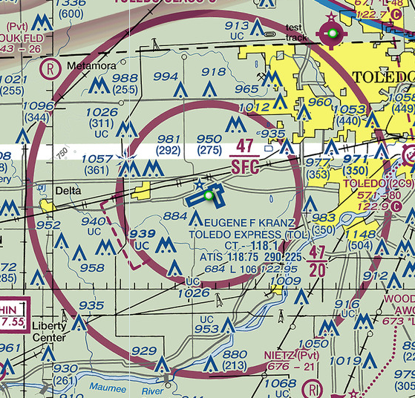
Airspace
Typically, 4,000 feet AGL and charted in MSL.
KTOL Class C goes up to 4,700 MSL
KTOL field elevation is 684 MSL
4,700
- 684
4,016
ACS - PA.I.E.K1

Slide 7
Airspace
Q
How high does Class D airspace typically extend?
How wide is Class D airspace?
AIM 3-2-5 (a)

Slide 8
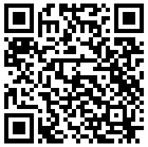
Airspace
The actual radius may vary airport to airport based on geography, adjacent airspace, and operational needs. FAA Order JO 7400.11J lists the Class D airspace dimensions for each airport.
4-5-mile radius
2,500 AGL
ACS - PA.I.E.K1–K2

Slide 9
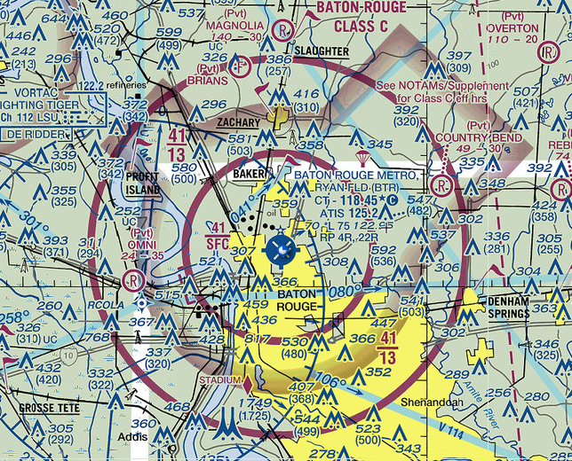
Airspace
Q
You are planning a VFR cross country to KBTR, what equipment do you need to enter their airspace?

Slide 10
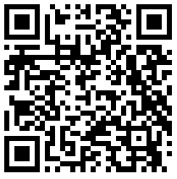
Airspace
After you review your sectional, you’ll find KBTR is Class C airspace so you need a transponder, ADS-B out, and a radio.

Slide 11
Airspace
Q
Class A airspace exists to what altitude?
What class airspace is above Class A airspace?

Slide 12
Airspace
Class A airspace extends from 18,000 MSL to FL600.
Above FL600, the airspace becomes Class E.

Slide 13
Airspace
Q
What equipment do you need to fly in Class B airspace?

Slide 14

Airspace
Radio
ADS-B Out
Transponder
And when you start your instrument training:
VOR or FAA Approved GPS System if flying IFR.

Slide 15
Airspace
Q
You are in Class E airspace. To avoid clouds, you climb to 13,000 MSL. What equipment is required?
AIM 3-2-6 (b)(2)
91.215

Slide 16
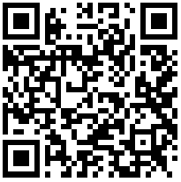
Airspace
ADS-B out and transponder are required above 10,000 MSL.
If you are below 2,500 AGL, transponder and ADS-B out is not required.
But…(there is always a “but”), if you have a transponder installed and operational, it must ALWAYS be turned on no matter where you are.

Slide 17
Airspace
Q
Can you fly through restricted airspace?
AIM 3-4-3

Slide 18
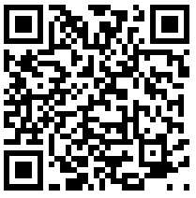
Airspace
Yes.
You must receive clearance from the controlling agency (usually ATC). The odds of that happening are pretty low.

Slide 19
Airspace
Q
What is the radius of Class C airspace?
How high does it extend up to?
AIM 3-2-4 (a)

Slide 20

Airspace
Class C typically takes the shape of a two-tiered, upside down wedding cake. The inner portion has a 5nm radius and the outer portion has a 10nm radius. It usually extends to 4,000 AGL.
10nm
4,000 AGL
1,200 AGL
Surface
5nm

Slide 21
Airspace
Q
You are approaching Class C airspace. It is apparent they are very busy. You make your initial call to ATC and they simply respond with “Cherokee N823B Standby.” Can you enter their Class C airspace?
AIM 3-2-4 (c)(3) Note 1.

Slide 22
Airspace
Yes. You must establish two-way radio contact. When ATC responds with your callsign, two-way communications are considered established.
If ATC doesn’t include your callsign in their call, you cannot enter the Class C. An example would be “Last calling approach, standby.”

Slide 23
Airspace
Q
You are flying into a small airport to visit a friend. The VFR sectional has no indications that it is Class D airspace and yet, there is a control tower with people in it talking on the radio. Is the VFR sectional wrong?

Slide 24
Airspace
No. It is not Class D airspace.
There are some airports with towers and yet are not designated as Class D airspace. This occurs if the tower doesn’t have any weather reporting capability.
Ground based airspace control is not authorized if the agency doesn’t have weather reporting capability. Therefore, in this case, there is no controlled airspace around the airfield.

Slide 25
Airspace
Q
You're flying into KBFF and the ceilings are coming down quickly. The weather is 7 miles visibility and 900 foot ceiling. You are a non-instrument rated private pilot. Can you land there?
91.155(c)

Slide 26
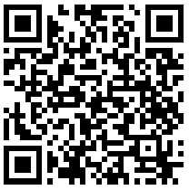
Airspace
No.
A chart review shows Class E extending to the surface around KBFF. According to 91.155(c), you cannot fly within the lateral limits of controlled airspace that extends to the surface when the ceiling is less than 1,000 feet. You can, however, pick up a Special VFR clearance and proceed as planned. Note: since there is no tower to issue a SVFR clearance, you would need to contact Flight Service or ATC to coordinate the SVFR clearance.

Slide 27
Airspace
Q
You are flying a cross country in Class E airspace at 6,000 MSL. Your transponder is broken. Is this ok?
AIM 3-2-6 (b)(2)

Slide 28
Airspace
You are fine. Class E airspace below 10,000 MSL requires no special type of equipment.
With that being said, if your transponder is installed and functioning, it must be turned on.

Slide 29
Airspace
Q
How far out past the coastline does U.S. airspace extend?
AIM 3-2-6 (d)(1)

Slide 30
Airspace
12nm.
Incidentally, 12nm also defines the beginning of international waters.

Slide 31
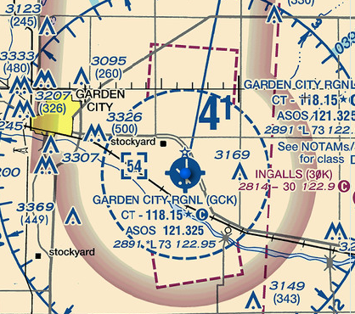
Airspace
Q
What class airspace is around KGCK?

Slide 32
Airspace
The blue dashed circle tells us KGCK is Class D. The gradient magenta line says the Class E around KGCK drops to 700 AGL. The dashed magenta line means the Class E goes to the surface within those areas.
Notice the asterisks in the airport info block? This means the tower is part time. The KGCK Class D reverts to Class E to the surface when the tower is closed.

Slide 33
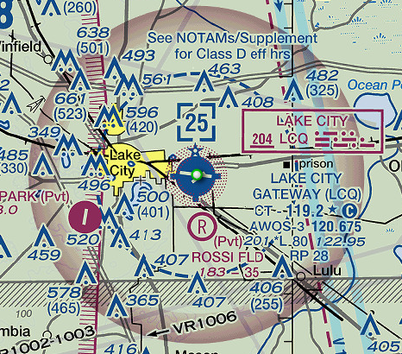
Airspace
Q
You’re flying into KLCQ on a cool and refreshing Sunday. What equipment do you need?

Slide 34

Airspace
If you review the Chart Supplement (AF/D) you’ll see the tower is closed on Sundays so there is no Class D. Therefore, no equipment is required.
Note: With that being said, if you have an installed and operable transponder, it must be on.

